Slide 1

Enterprise Process Management
Progressive approach towards building a Business Architecture strategy

Slide 2

Agenda
Opening Comments
Shift from Process Mapping to Process Modeling
Building Sustainable Value
Learning to Pass the Baton
Making 4 New Friends
Adaptability, Agility & Accountability
Managing Change
Accelerating the Pace of Change
Service Excellence (A 360° View)
EPM Pilot
EPM Roadmap
Key Messages
Q&A

Slide 3
Opening Comments
The meeting WILL NOT…….
  Answer All Questions
  Suggest that an IT Software Tool is the solution to business process issues.
  Suggest that the proposal to consider EPM is driven by a QRA need.
The meeting WILL………
  Suggest that Hospira needs to build sustainable value by modeling business processes.
  Build an awareness and understanding of why we should consider adopting a process modeling approach.
  Develop a heightened interest in EPM to build support and momentum for investing in a feasibility effort.

Slide 4
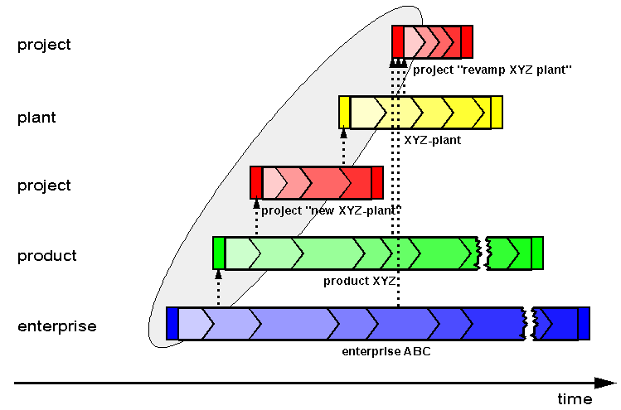
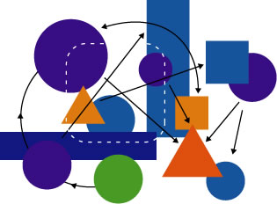
Shift to a Process Modeling Approach

Slide 5

Shift to a Process Modeling Approach
Function oriented
Build to last
Long turnaround cycles
Process oriented
Build to change
Supports process optimization
Service & Customer Focus
Planning change is easy
Flexible & Agile
Adaptable
Manageable Risk
Functional silos
Decentralized planning
Process Inflexibility
Change is difficult
High Risk
Notes:
------------------------------------------ ROGER --------------------------------------------------------
The 90s have been focusing on functional enrichment for applications and resulting best-of-breed. SAP has been the winner of the game with the top-functional ERP solution. Customers have deployed solutions around the globe and integrated them. A monolithic landscape – hardly to change – has derived from that. Examples are: BAYER !!
Today's dogma is CHANGE!
Which is hard for today's software architecture to adopt. For example see: P2P integration, supply chain integration, adopting new business models, M&A, consolidation of processes.

Slide 6
Building Sustainable Value
Examples of Key Drivers | How can Process Modelling help ?
Reduce IT costs Support agility and growth Adaptability Improved Integration Optimize Collaboration Align with business models Streamline Processes Improve Productivity | Lower workload: Ability to build & deploy process templates Less effort to change processes Leveraging baseline processes Transfer of process knowledge Lower costs: Centralized repository of all processes Improved Integration Reusable Processes & Business Rules Elimination of redundant IT Systems/Processes Flexibility: Centralized management of Metadata and metrics Ability to plan change more quickly Ability to adapt processes using Metadata Process Automation: Workflows across applications Automation of manual processes Process integration with business partner
Notes:
Verify the business drivers at the start of the presentation
Find examples for the SOA/ESA accelerators

Slide 7
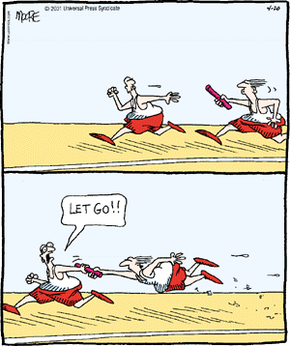
Learning to Pass the Baton
The key to successful process modeling is identifying the key handoffs between suppliers and consumers of services.
Everyone needs to own, and understand, how their piece impacts the whole in order to properly “handoff” and ensure their part of the bargain for service excellence is met.

Slide 8
Making Four New Friends
Who, What, Where, How, When & Why
Traditional focus is on “What and Who”. Answers to all six helps with framing the business rules for directing the behavior of business processes.
The challenge is capturing all of these rules in a centralized manner where they can be applied to baseline processes to create all of the different “flavors” of processes to meet our business needs.
Notes:
Current restrictions:
Multiserver environment
Decentral data management
P2P integration
Poor reuse of assets/programs within SAP
Monolithic structure unlikely to adapt change
→ Integration is the story (services, partners, data…)
Lack of business agility and flexibility
slow in addressing changing business requirements
Increasing complexity and little re-use
Monolithic applications and tightly coupled rigid systems - very fragile
multiple development platforms, tools, and support teams
custom point to point interfaces – expensive and complex to maintain
Lack of interoperability
Difficultly in quickly deploying industry standards
Data quality and data management issues -
Multiple, inconsistent sources exist for each data entity (master data)
Infrastructure delays due to replication and nightly batch processing
Difficulty integrating data in real-time data based on business events

Slide 9
Adaptability, Agility & Accountability
Now that we’re accustomed to change…
The pace of change is about to increase
EPM will provide bring an agile capability for planning & managing process change
EPM requires a new sense of accountability by process owners
EPM will provide new insights and analysis about process management that will lead to building service excellence
Processes need to be more fluid and adaptable to accommodate changes in business:
        Expanded Product Portfolio w/ New Products
        Changing Compliance & Reporting Requirements
        Merger & Acquisition Planning & Execution
Notes:
-------------------------------------------------------------ROGER---------------------------------------------------------------
SAP has learned that current requirements can not be delivered by a monolithic R/3 architecture.
Current restrictions:
Multiserver environment
Decentral data management
P2P integration
Poor reuse of assets/programs within SAP
Monolithic structure unlikely to adapt change
→ Integration is the story (services, partners, data…)

Slide 10

Managing Change
Keep it Simple St----- !
  Start out with a simple model (see below) and add process and complexity gradually (when necessary).
  Build an agile governance model
  Establish tiers of involvement
    Change w/in a process area
    Change btwn process areas
    Change btwn organizational areas
Here is where we plan change
R&D
Process
Governance
New
Products
Changes
To
Products
Post Market
Surveillance
Manual
SOPs
Version
Mgmt
Here is where we execute change
Automated
Workflows
&
Processes

Slide 11
Accelerating the Pace of Change
Once we establish a baseline set of models, we need to be prepared to accommodate changes at a pace that keeps up with the business.
  We will need to establish a lightweight governance framework to manage change requests, make decisions and update the process models.
  We will need to leverage an enterprise modeling tool to help plan (impact analysis) and execute changes to process models.
  We will need to establish a simple communications mechanism to introduce change to process owners.

Slide 12
Service Excellence (A 360° View)
Service
Portfolio
Mgmt
Process
Modeling
Continuous
Improvement
Governance
&
Change Mgmt
Metrics
&
Reporting

Slide 13
Demo: Where tools can help

Slide 14
EPM Pilot
’06 Q3
’06 Q4
’07 Q1
’07 Q2
’07 Q3
’07 Q4
Raise Awareness, Establish Support
Research Products & Conduct Feasibility Analysis
Implement Tool
Conduct EPM Pilot (*)
Review Pilot Results
& evaluate Next Steps
Go / No Go
Decision
Begin / Continue Mapping the “As Is” Processes
Begin defining the “To Be” (future State) Processes
Begin / Continue collecting metrics & producing reports
(*) Begin building the As Is Process Models for one area :
3 Process Areas (New Product, Change to Product & Post Market Surveillance)
Bring in Modeling Expert to jumpstart effort
Notes:
----------------------------------------------------------ROGER------------------------------------------------
Take details from the Astra Zeneca case??

Slide 15
EPM Roadmap
’07 Q2
’07 Q3
’07 Q4
’08 Q1
’08 Q2
’08 Q3…
Purchase Tool
Continue building the Process Models for each area
Build transition plan to move
from process mapping
to process modeling
Implement KISS
Change Mgmt
Define & Implement
EPM Governance
Implement Continuous Improvement
Notes:
----------------------------------------------------------ROGER------------------------------------------------
Take details from the Astra Zeneca case??

Slide 16
Key Messages
Recognize the need for an enterprise approach for process modeling
Understand the value that technology can bring to process modeling.
Appreciate the need for building lightweight governance to maintain and accelerate the pace of change.
Get the big picture for building service excellence.
Thank You

Slide 17
Q & A
Thanks for your time…

